Slide 1
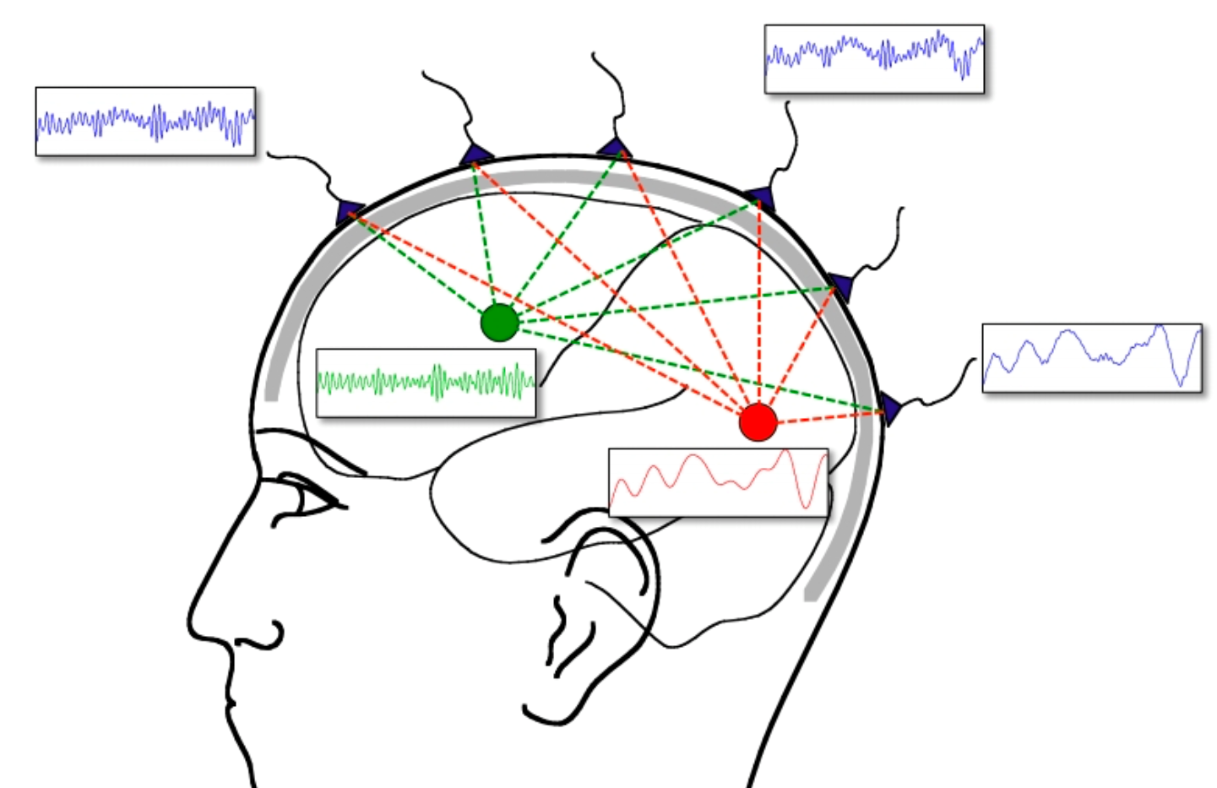
Generator localization by current source density (CSD): Implications of volume conduction and field closure at intracranial and scalp resolutions
Craig E. Tenke and Jürgen Kayser

Slide 2
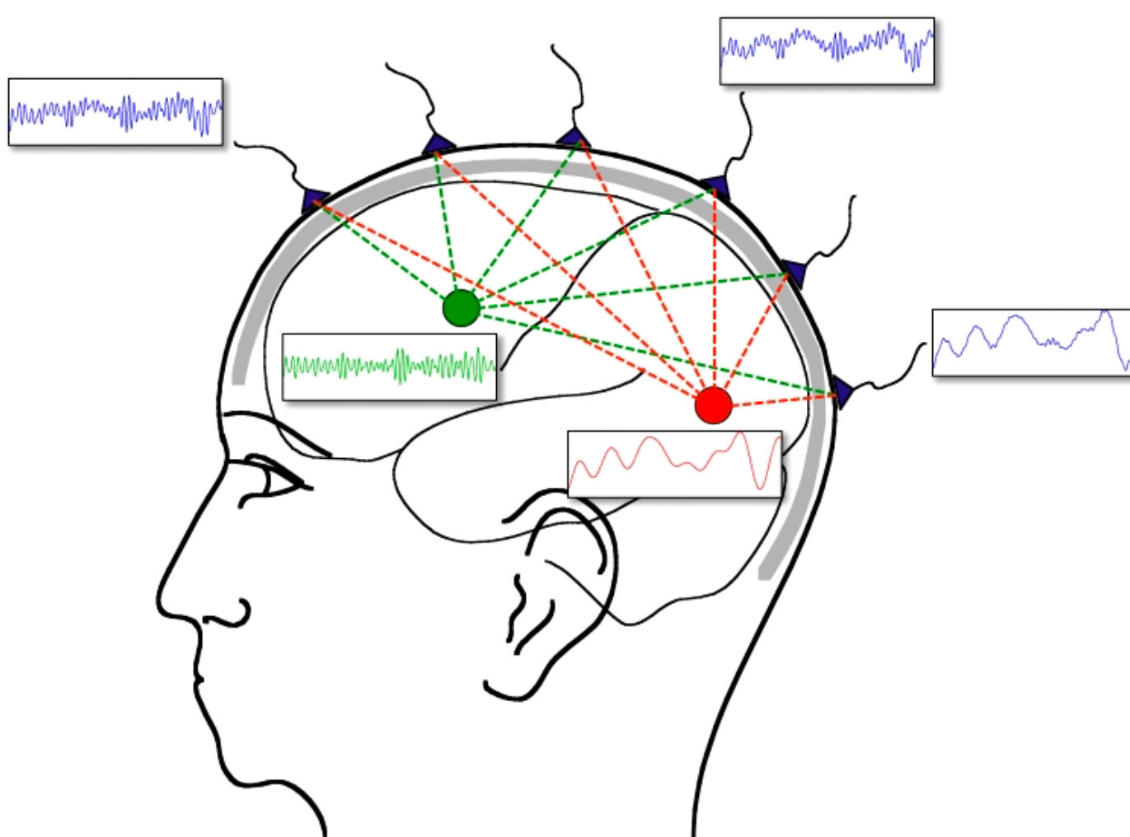
The Issues
Event related potentials (ERPs) can be obscured by the overlap in time and space from simultaneous activity within multiple neuronal regions and networks.
Electrical measurements are potential differences (i.e., voltages), the voltage measured at one electrode contact could originates from activity near the “indifferent” recording reference.

Slide 3
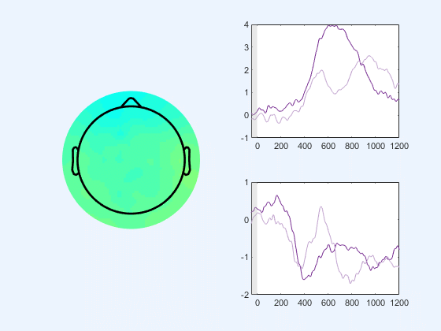
The Issues
Original
CPP
Event related potentials (ERPs) can be obscured by the overlap in time and space from simultaneous activity within multiple neuronal regions and networks.
Electrical measurements are potential differences (i.e., voltages), the voltage measured at one electrode contact could originates from activity near the “indifferent” recording reference.
Issues arise when manipulation have effect on two neighboring signal, like illustrated by Jess’s gap data.
Gap
N2
Notes:
Although the effect aren’t synchronized

Slide 4
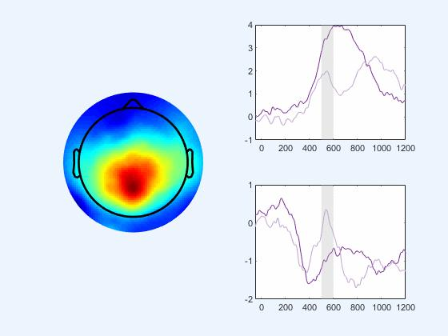
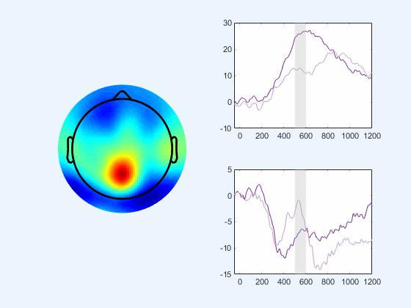
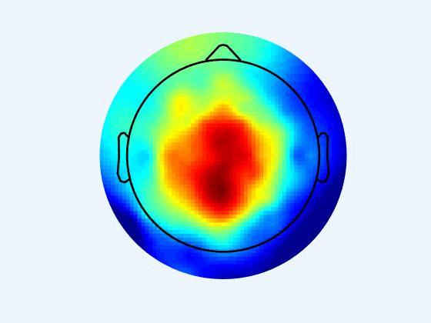
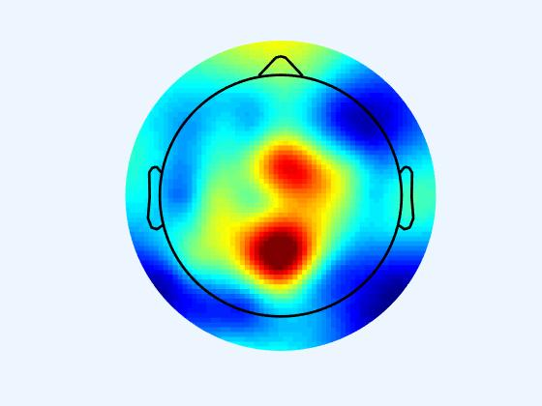


The Issues
Original
CSD transformed
$$∆$$
$$∆$$

Slide 5
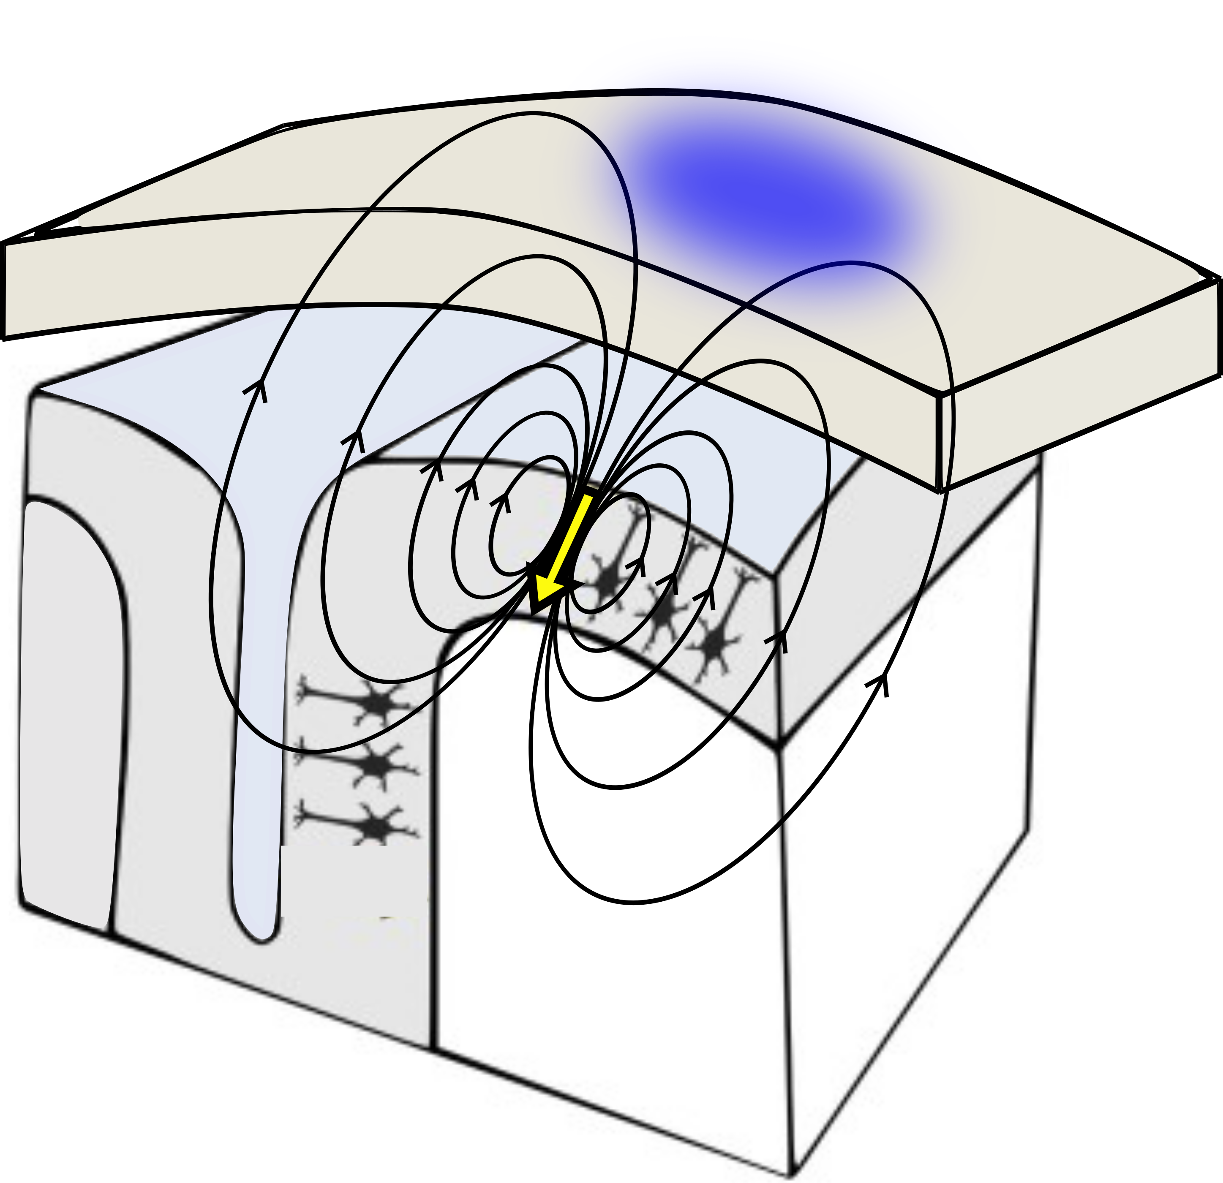
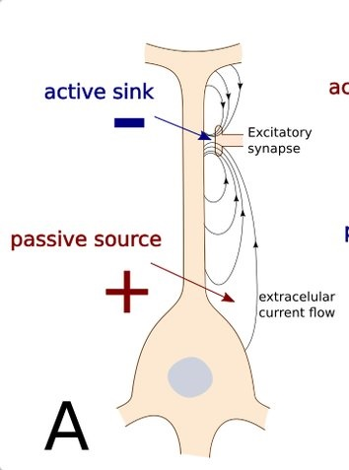
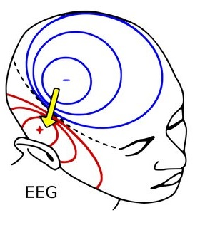
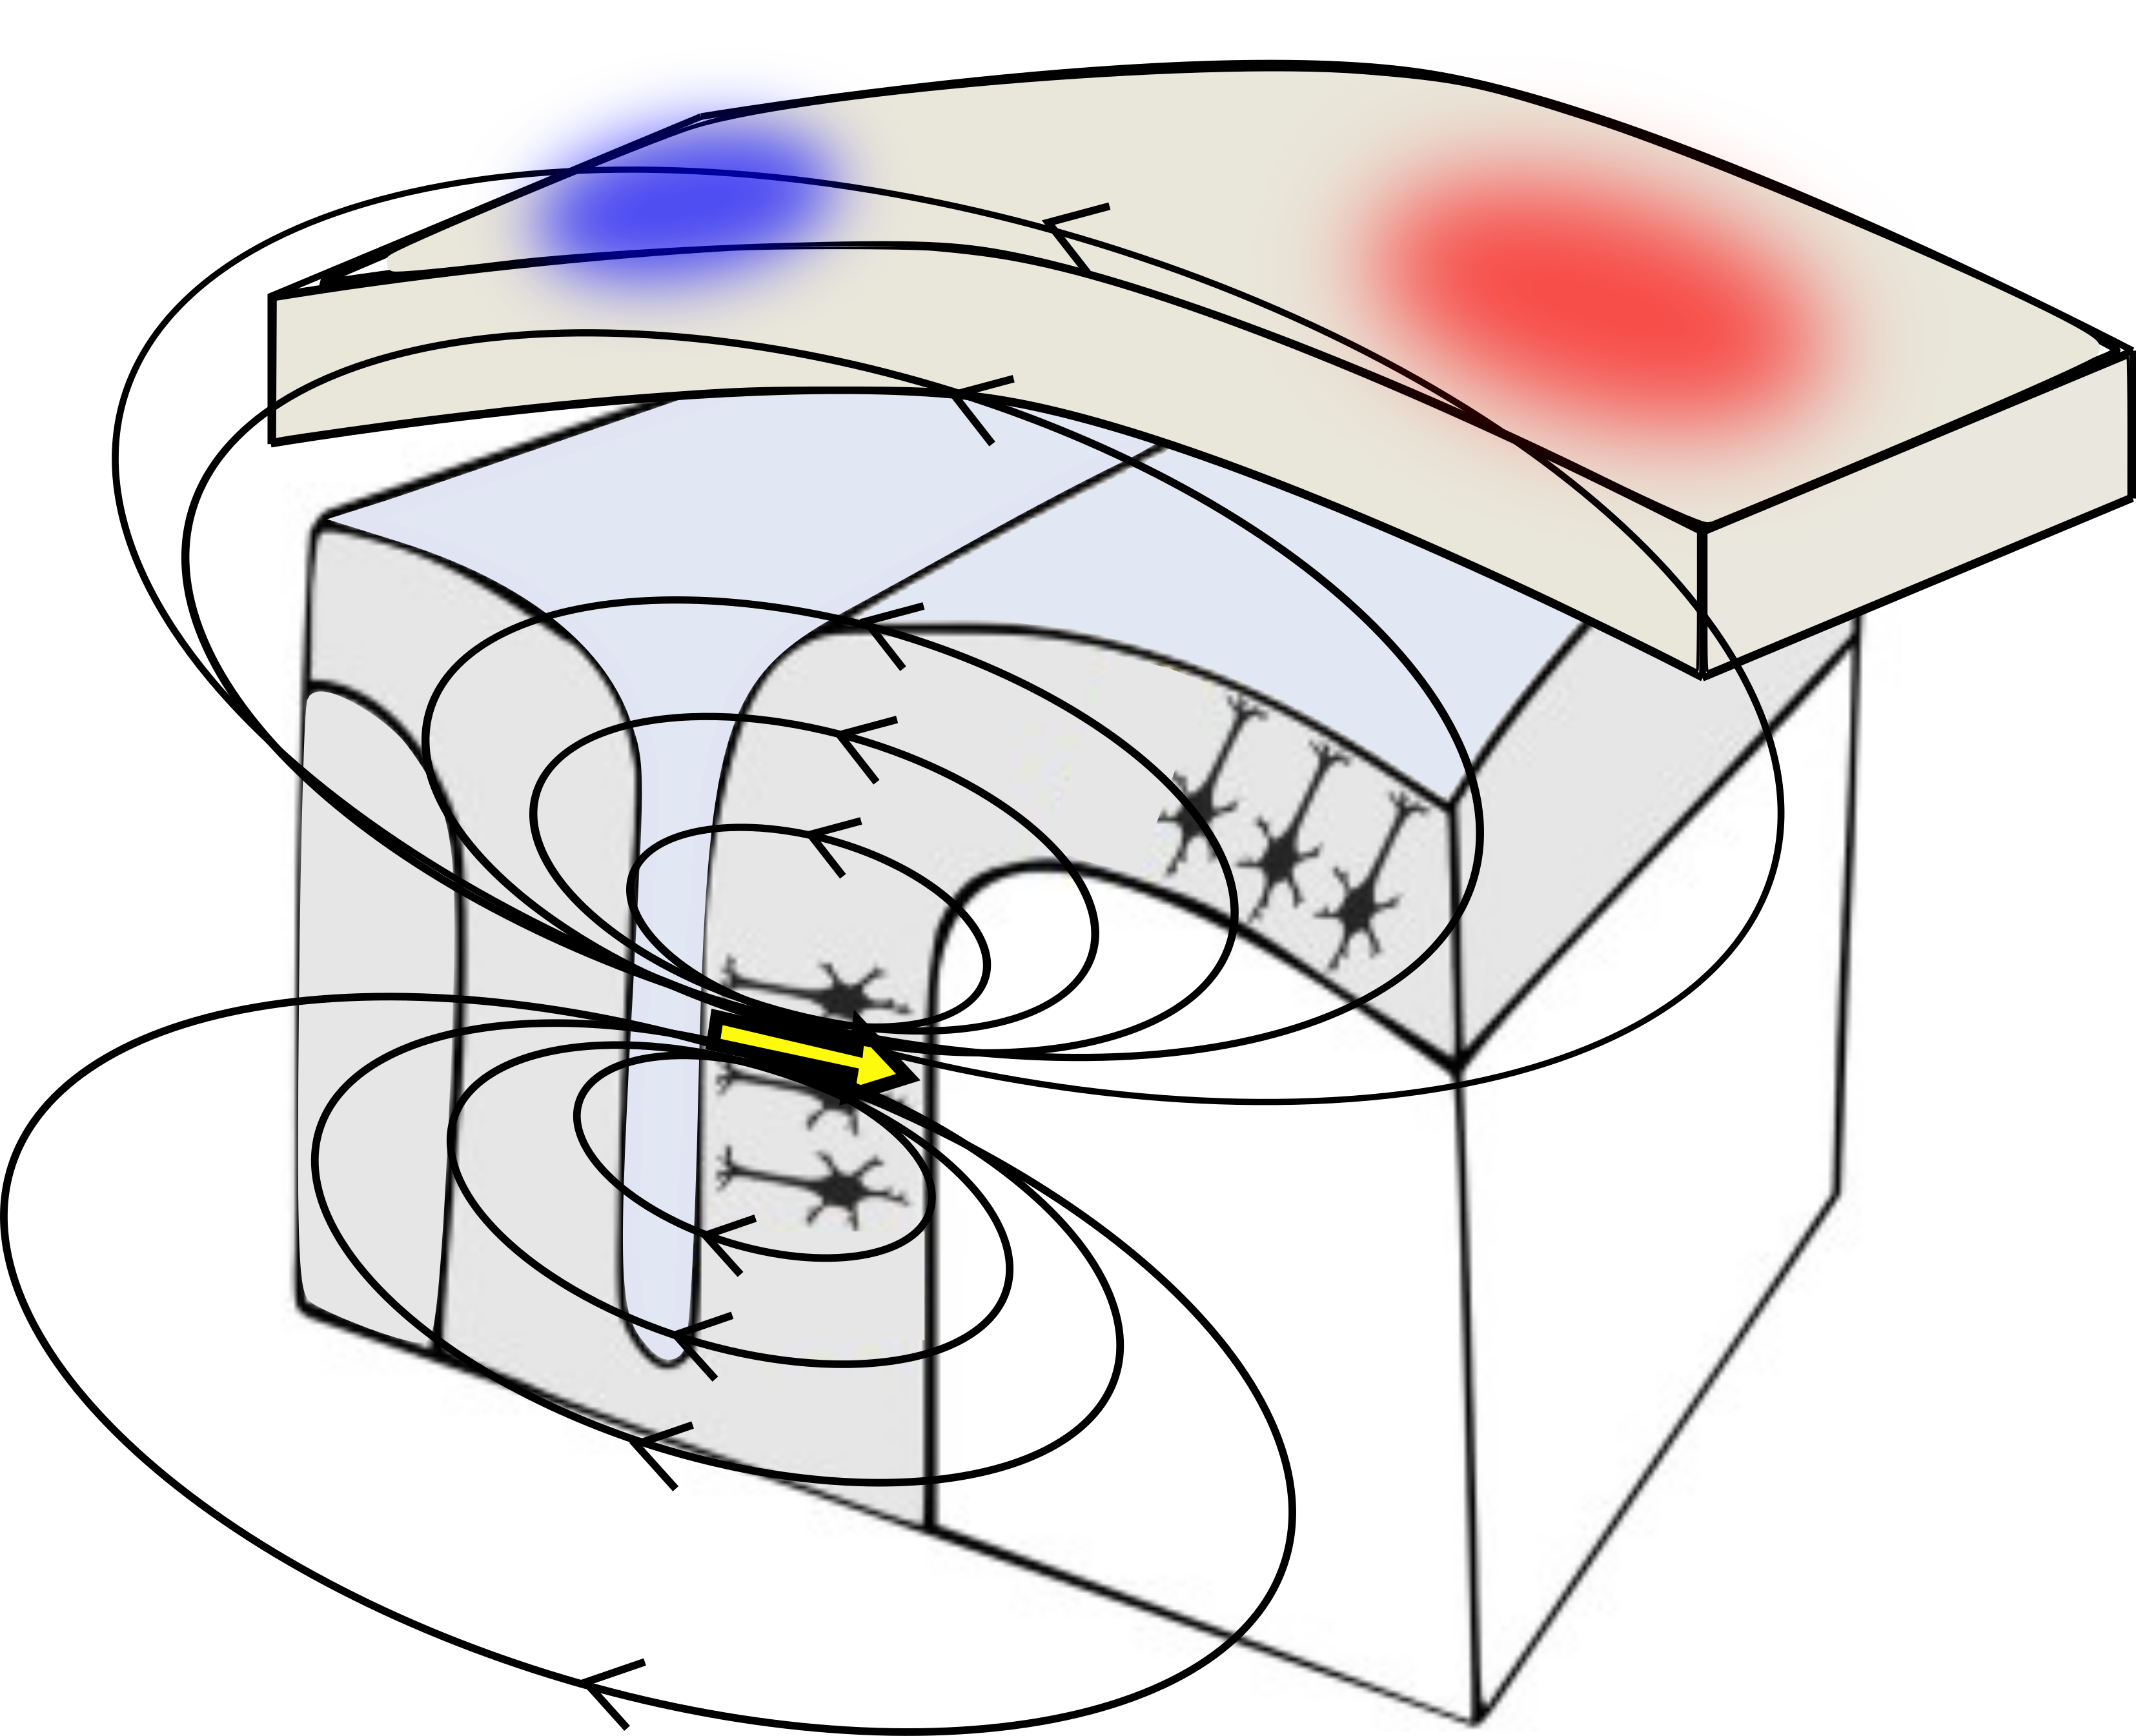
Biophysics
Radial
Tangential
An extracellular flow of current into, e.g., extracellular sink and negativity and out of, e.g., extracellular source and positivity the cell from the extracellular medium creating dipoles.
EEG reflect the summation of numerous, small dipoles of aligned neurons creating a net current measured across the tissue between the generator and the recording electrode.
The necessary circuit closure for these currents is through the intracellular compartment, which is not generally visible to a recording contact in the extracellular medium, creating an electrical circuit.
Notes:
balance between intra- and extracellular processes associated with the neuronal resting potential, but are only evidenced by flow of current into (depolarization; extracellular sink and negativity) and out of (hyperpolarization; extracellular source and positivity) the cell from the extracellular medium. → The necessary circuit closure for these currents is through the intracellular compartment, but is not generally visible to a recording contact in the extracellular medium

Slide 6
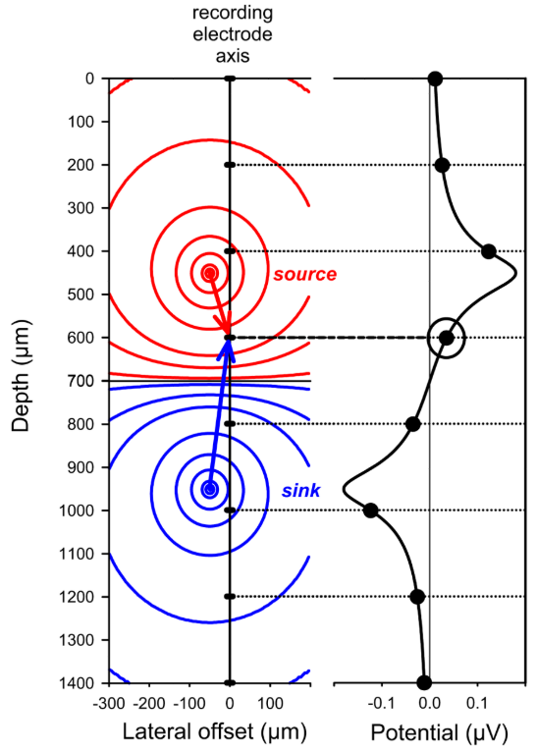
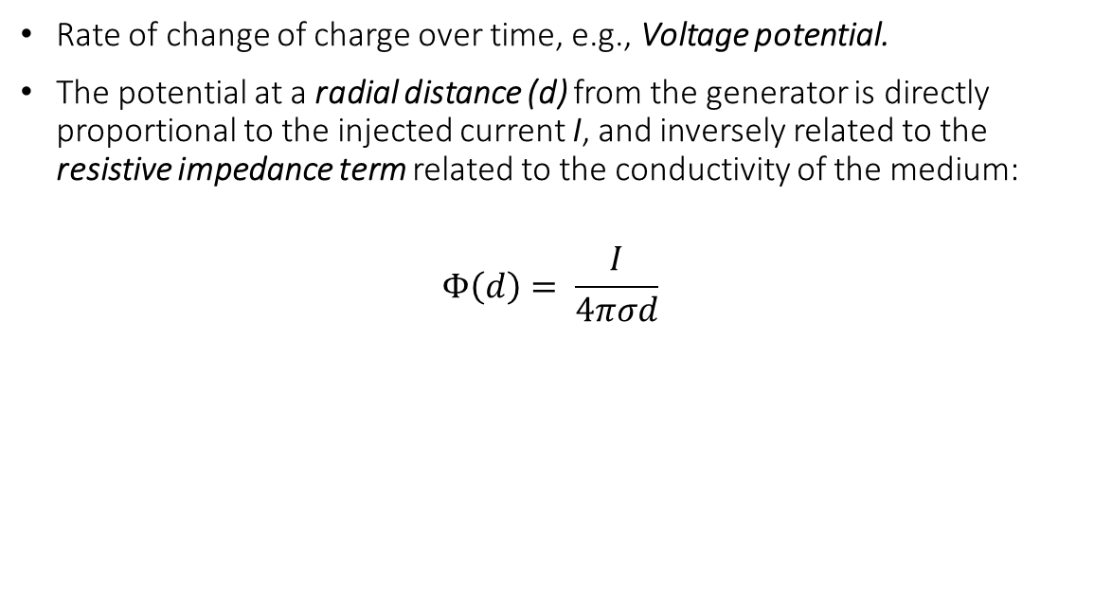
From generator to measured voltage
Rate of change of charge over time, e.g., Voltage potential.
The potential at a radial distance (d) from the generator is directly proportional to the injected current I, and inversely related to the resistive impedance term related to the conductivity of the medium:
$$Φ\left(d\right)= \frac{I}{4πσd}$$

Slide 7
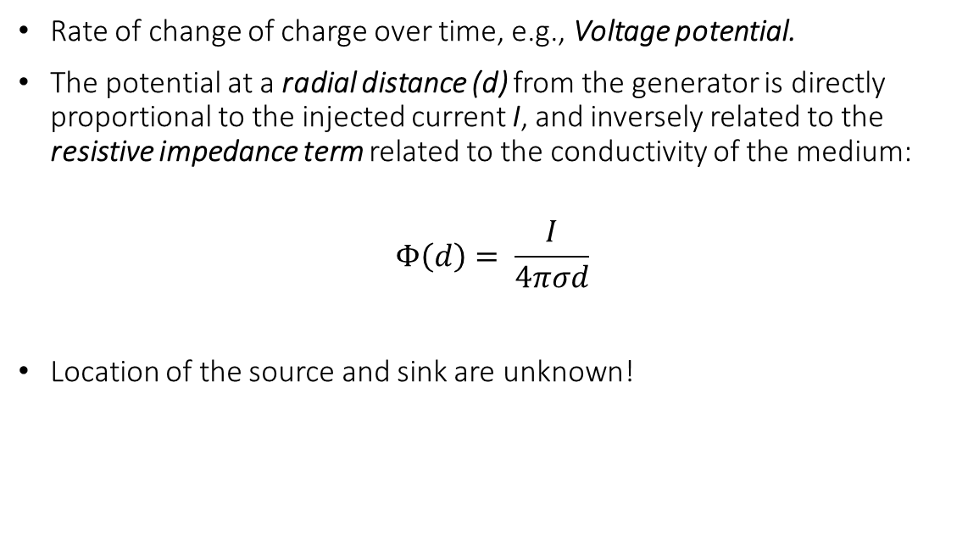
From generator to measured voltage
Rate of change of charge over time, e.g., Voltage potential.
The potential at a radial distance (d) from the generator is directly proportional to the injected current I, and inversely related to the resistive impedance term related to the conductivity of the medium:
$$Φ\left(d\right)= \frac{I}{4πσd}$$
Location of the source and sink are unknown!
?
?

Slide 8
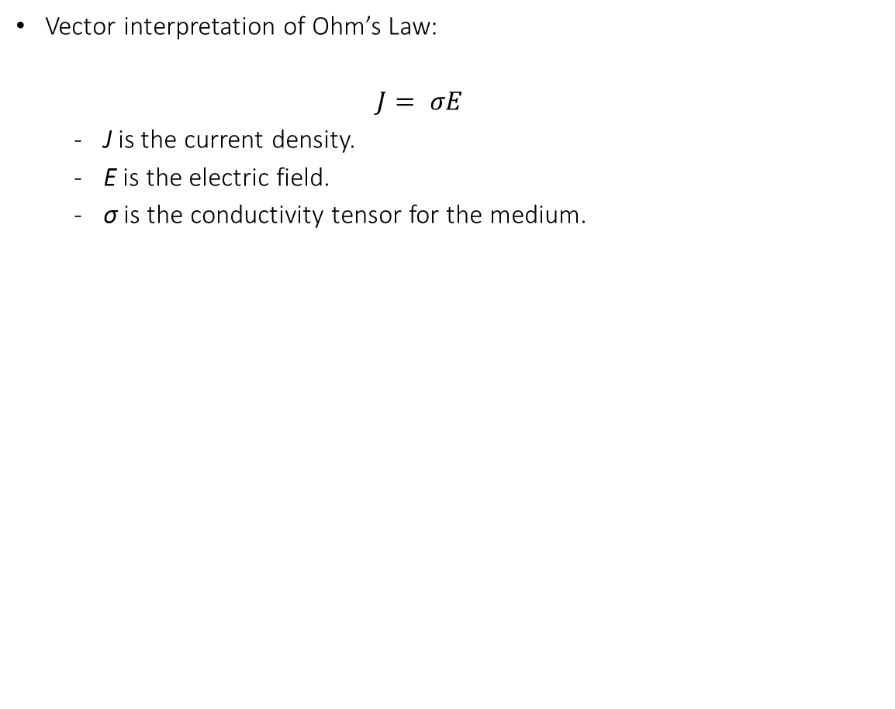
From generator to measured voltage
Vector interpretation of Ohm’s Law:
$$J= σE$$
﻿J is the current density.
E is the electric field.
σ is the conductivity tensor for the medium.

Slide 9
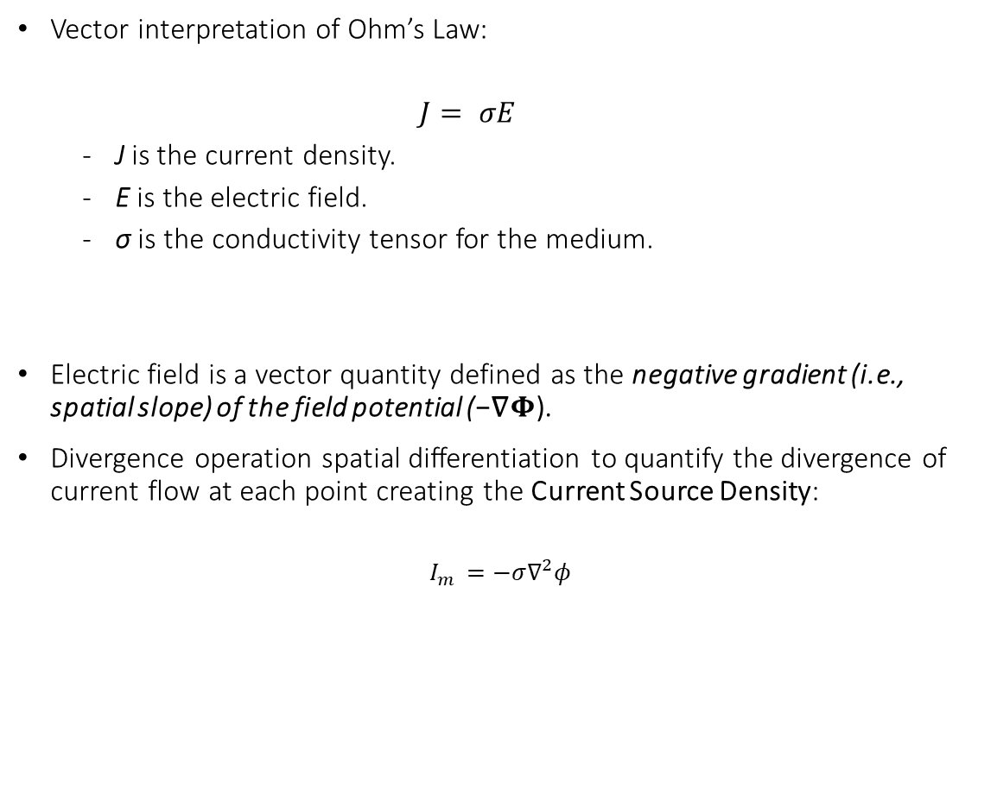
From generator to measured voltage
Vector interpretation of Ohm’s Law:
$$J= σE$$
﻿J is the current density.
E is the electric field.
σ is the conductivity tensor for the medium.
Electric field is a vector quantity defined as the negative gradient (i.e., spatial slope) of the field potential (−∇$Φ$).
Divergence operation ﻿spatial differentiation to quantify the divergence of current flow at each point creating the Current Source Density:
$$I_{m }=−σ∇^{2}φ$$

Slide 10

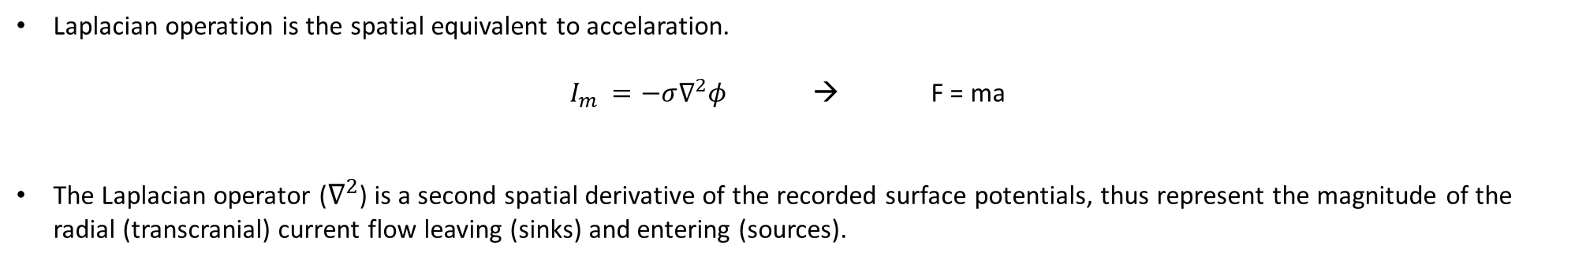
Laplacian operator ($∇^{2}$)
Laplacian operation is the spatial equivalent to accelaration.
$I_{m }=−σ∇^{2}φ$ → F = ma
The Laplacian operator ($∇^{2}$) is a second spatial derivative of the recorded surface potentials, thus represent the magnitude of the radial (transcranial) current flow leaving (sinks) and entering (sources).

Slide 11
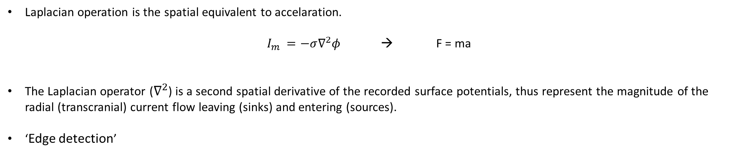
Laplacian operator ($∇^{2}$)
Laplacian operation is the spatial equivalent to accelaration.
$I_{m }=−σ∇^{2}φ$ → F = ma
The Laplacian operator ($∇^{2}$) is a second spatial derivative of the recorded surface potentials, thus represent the magnitude of the radial (transcranial) current flow leaving (sinks) and entering (sources).
‘Edge detection’

Slide 12
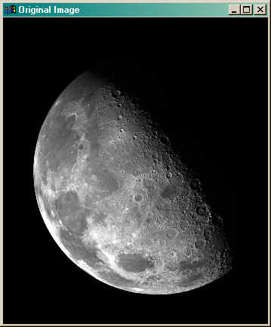
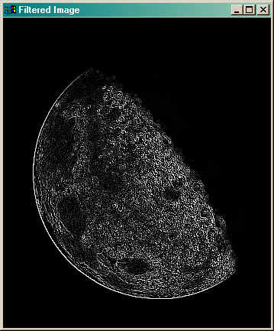
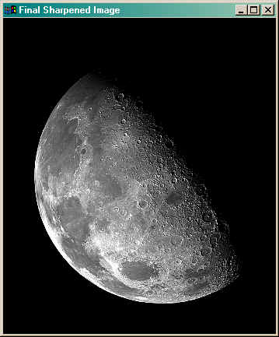
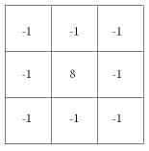
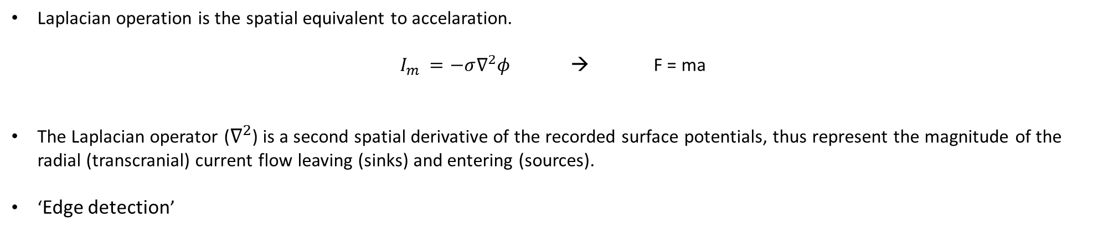
Laplacian operator ($∇^{2}$)
Laplacian operation is the spatial equivalent to accelaration.
$I_{m }=−σ∇^{2}φ$ → F = ma
The Laplacian operator ($∇^{2}$) is a second spatial derivative of the recorded surface potentials, thus represent the magnitude of the radial (transcranial) current flow leaving (sinks) and entering (sources).
‘Edge detection’
Original image
Laplacian kernel
Filtered image
Original image
Sharpened image
*
=
+
=

Slide 13
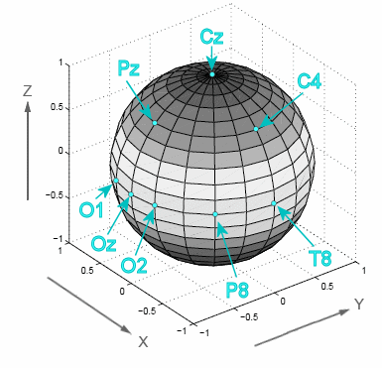
CSD toolkit implementation
Informed version using the spherical head model
Mapping the direction, location and intensity of current generators in two steps:

Slide 14
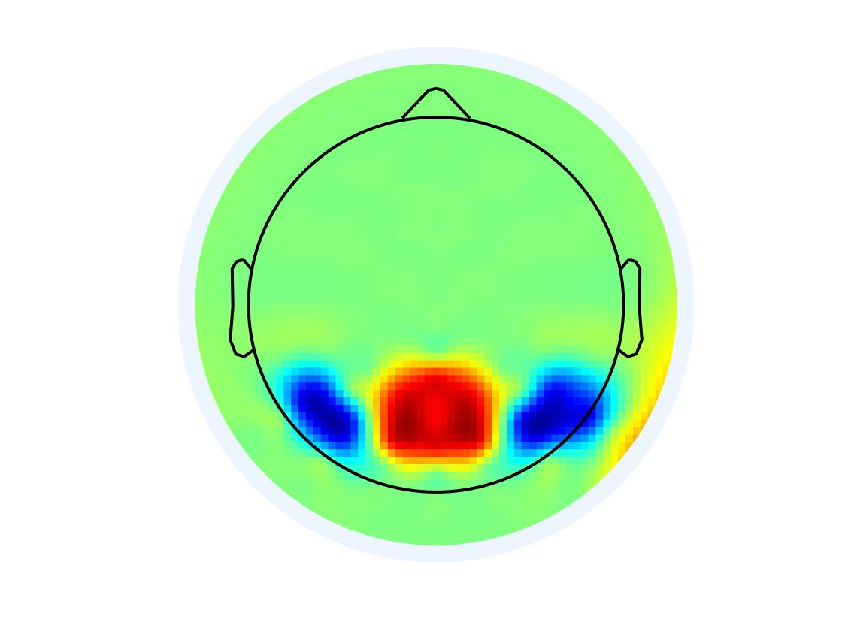
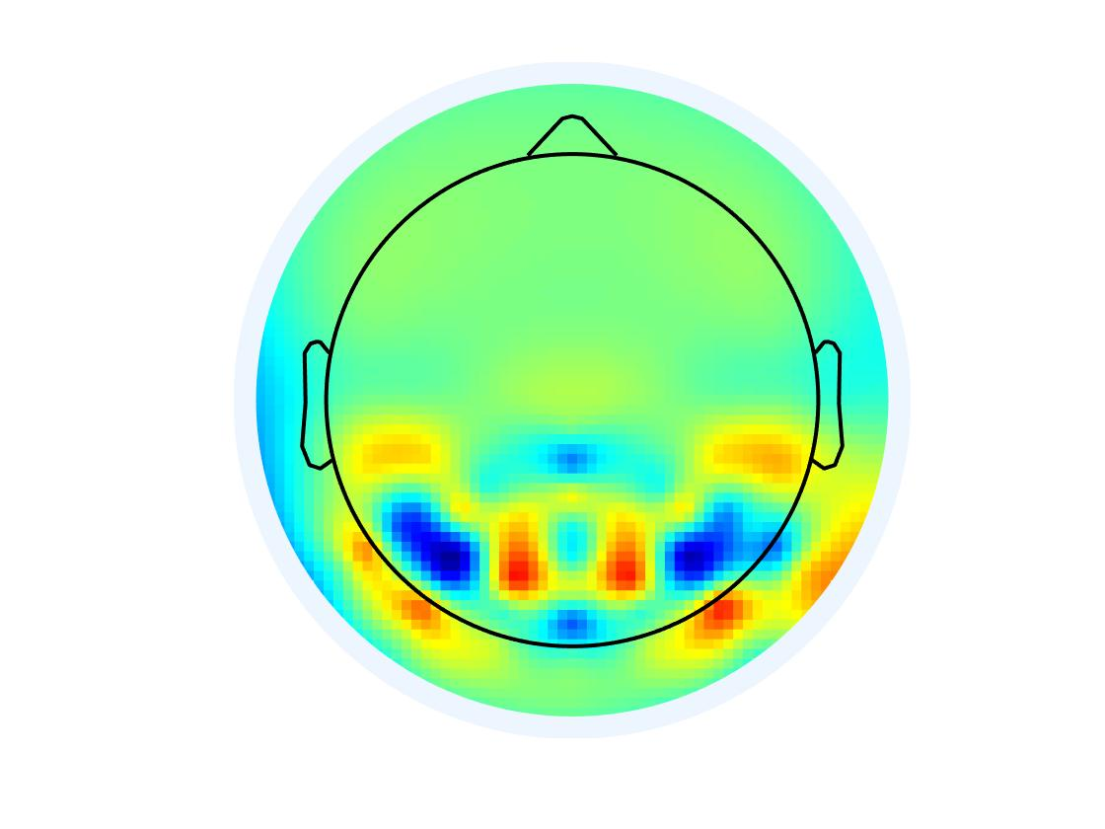
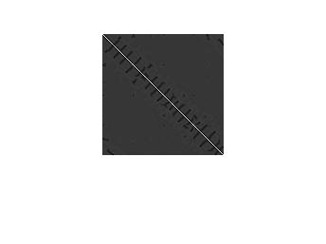
CSD toolkit implementation
Informed version using the spherical head model
Mapping the direction, location and intensity of current generators in two steps:
Spherical spline interpolation
Original image
Spherical spline
interpolation
*
=
*
1. Spherical interpolation

Slide 15
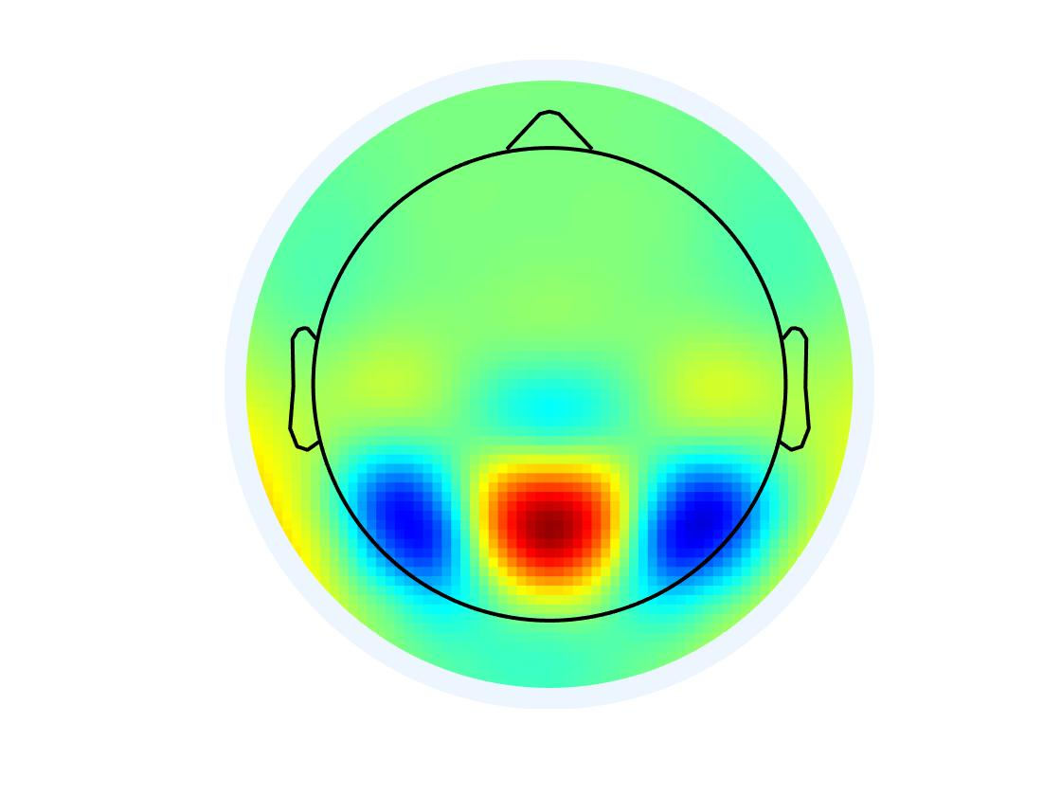
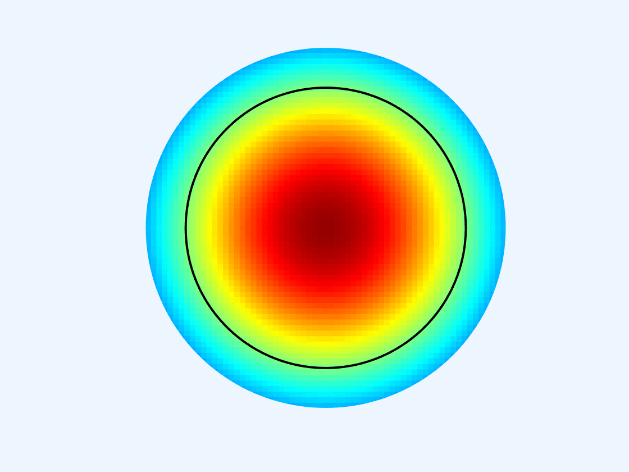
CSD toolkit implementation
Informed version using the spherical head model
Mapping the direction, location and intensity of current generators in two steps:
Spherical spline interpolation
Current source densities
Original image
Spherical spline
interpolation
Spherical Laplacian
Per channel
Scalp current density
estimations
*
=
*
=
*
1. Spherical interpolation
2. Current source density

Slide 16
HOWEVER
Spherical head model
Ignoring ﻿structural nuances (e.g., sulcus and gyrus), ignores location of dipoles in relation to the electrode (only radial not tangential), ignores electrode inversion, ignores possible closed fields.

Slide 17
HOWEVER
Spherical head model
Ignoring ﻿structural nuances (e.g., sulcus and gyrus), ignores location of dipoles in relation to the electrode (only radial not tangential), ignores electrode inversion, ignores possible closed fields.
A surface Laplacian computed from a scalp montage clearly does not reflect neuronal generators within that surface (i.e., the scalp), but rather the currents that impinge on the scalp radially from the brain.
The suitability rest on the plausibility and empirical value of the approach.

Slide 18
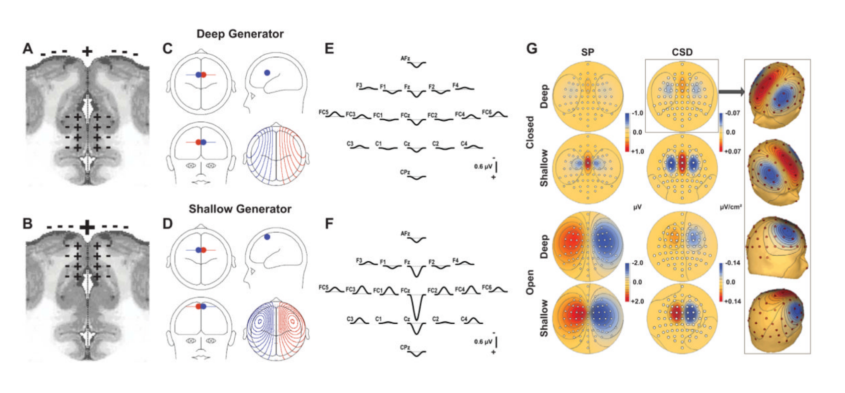
Problem with closed field
Asymmetric projection cells, considerable activity is locally cancelled.
Our decision should thus be based on the knowledge of the suspected generators.
Closed
Open

Slide 19
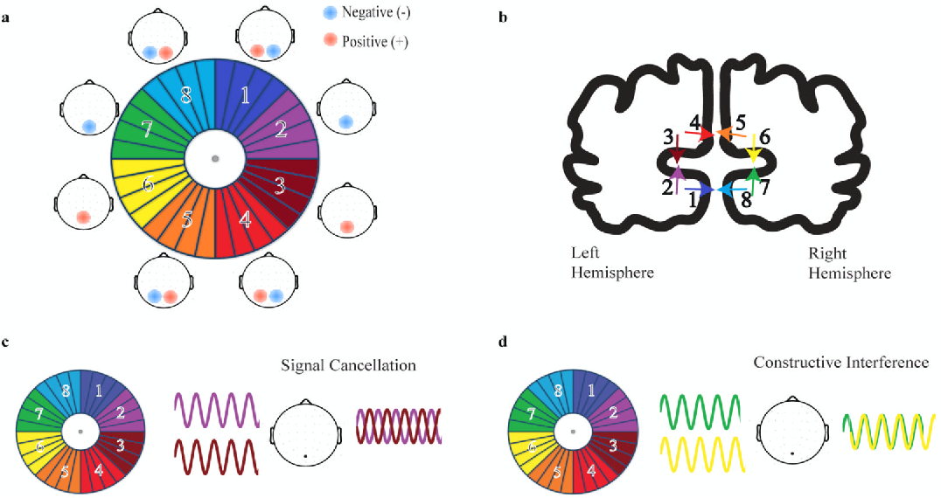
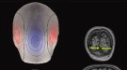
Cruciform shape of primary visual cortex
Primary visual cortex is located in the calcarine region, a sulcus, when simultaneously activating, it will create a closed field.
This creates central sink and bilateral sources.
Cruciform shape
EEG signal

Slide 20
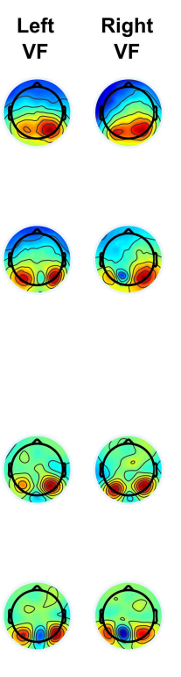
Cruciform shape of primary visual cortex
Primary visual cortex is locale in the calcarine region, a sulcus, when simultaneously activating, it will create a closed field.
This creates central sink and bilateral sources.
Kieran’s data P1
EEG signal
Cruciform shape
No CSD
CSD

Slide 21
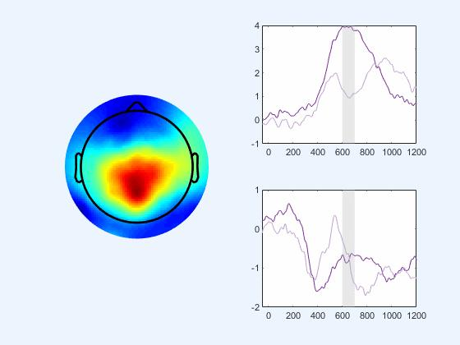
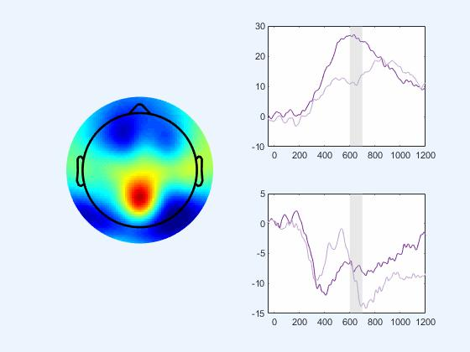
Origin of CPP and N2?
It is important for us to consider the origin of the signals and see if the CSD is not just emphazing effects.
?
Jess’ gaps effect?

Slide 22
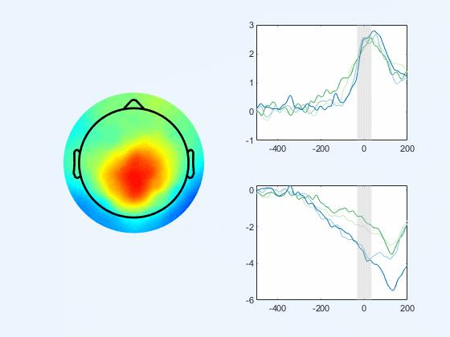
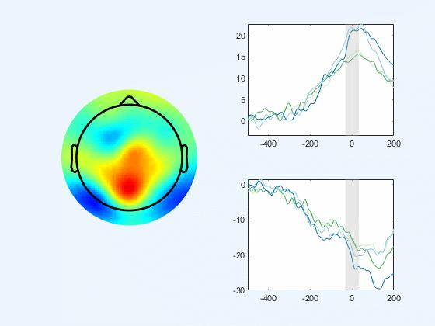
Origin of CPP and N2?
It is important for us to consider the origin of the signals and see if the CSD is not just emphazing effects.
?
Hannah’s Easy vs. Hard contex

Slide 23
Origin of CPP and N2?
It is important for us to consider the origin of the signals and see if the CSD is not just emphazing effects.
Using inverse methods to comfirm??

